Slide 1
The Role of the System Analyst
Introduction & Overview
Chapter 03

Slide 2
Objectives
By the end of this chapter, you should know –
What it takes to do system analysis.
The academic and personal qualifications of system analysts.
The multifaceted role of the analyst.
How to maintain proper interface with the user.
The behavioral issues that contribute to system success.
The place of the analyst in the MIS organization.

Slide 3
Introduction
By having crystal clarity of the role of the system analyst one can –
Understand the role of the analyst in system development.
Understand the interface maintained between the analyst and the user.
Design and implement systems to suit organizational needs.
Play a major role in seeing business benefit from computer technology.
Follow a structured framework and a disciplined approach to solve problems.

Slide 4
System Analyst
A system analyst is a person who conducts a methodical study, identifies and evaluates activities and their objectives and finally determines a procedure to achieve the objectives of a particular system.
Earlier analysts worked in factories, specializing on improving work methods and setting time standards for production.
With the advent of the computer, the analyst took the role of a problem solver and a specialist in developing computer applications.
The main task is to elicit needs and resource constraints and then translate them into a viable operation.

Slide 5
Skills Required for a System Analyst
An analyst must possess various skills to effectively carry out the job. They may be divided into two categories –
Interpersonal Skills focus on relationships and the interface of the analyst with people in business. They are useful in establishing trust, resolving conflict and communicating information.
Technical Skills focus on procedures and techniques for operating and assessing the system using the knowledge of computer science.
A successful analyst blends the realities of the human factor with the structured techniques and procedures that permit problem solution through the computer.
Both skills are equally important and required for a long-lasting interface.

Slide 6
Interpersonal Skills
Communication
Having the ability to articulate and speak the language of the user (i.e. talking, listening, feeling, reacting to one another as well as gathering their experiences and reactions)
Understanding
Identifying problems and assessing their consequences, having a grasp of company goals and showing sensitivity to the impact of the system on both people at work and user.
Teaching
Educating people regarding the use of computer systems, selling the system to the user and giving support when needed.
Selling
Selling ideas and promoting innovations in problem solving using computers.

Slide 7
Technical Skills
Creativity
Helping to model user ideas into concrete plans and developing candidate systems to match user requirements.
Problem Solving
Reducing problems to their basic levels for analysis and considering alternative solutions by comparing the pros and cons of candidate systems.
Project Management
Scheduling, performing well under timing constraints, coordinating team efforts and managing costs and expenditure.

Slide 8
Technical Skills
Dynamic Interface
Such user interfaces concern all kind of automatically generated user interfaces (e.g. the page may change with the time of day, the user that accesses the webpage, or the type of user interaction)
Questioning Attitude and Inquiring Mind
Having the curiosity to know the what, when, why, where, who and a how a system works.
Knowledge
Having basics of computer science, how a business function as well as organizational and managerial skills.

Slide 9
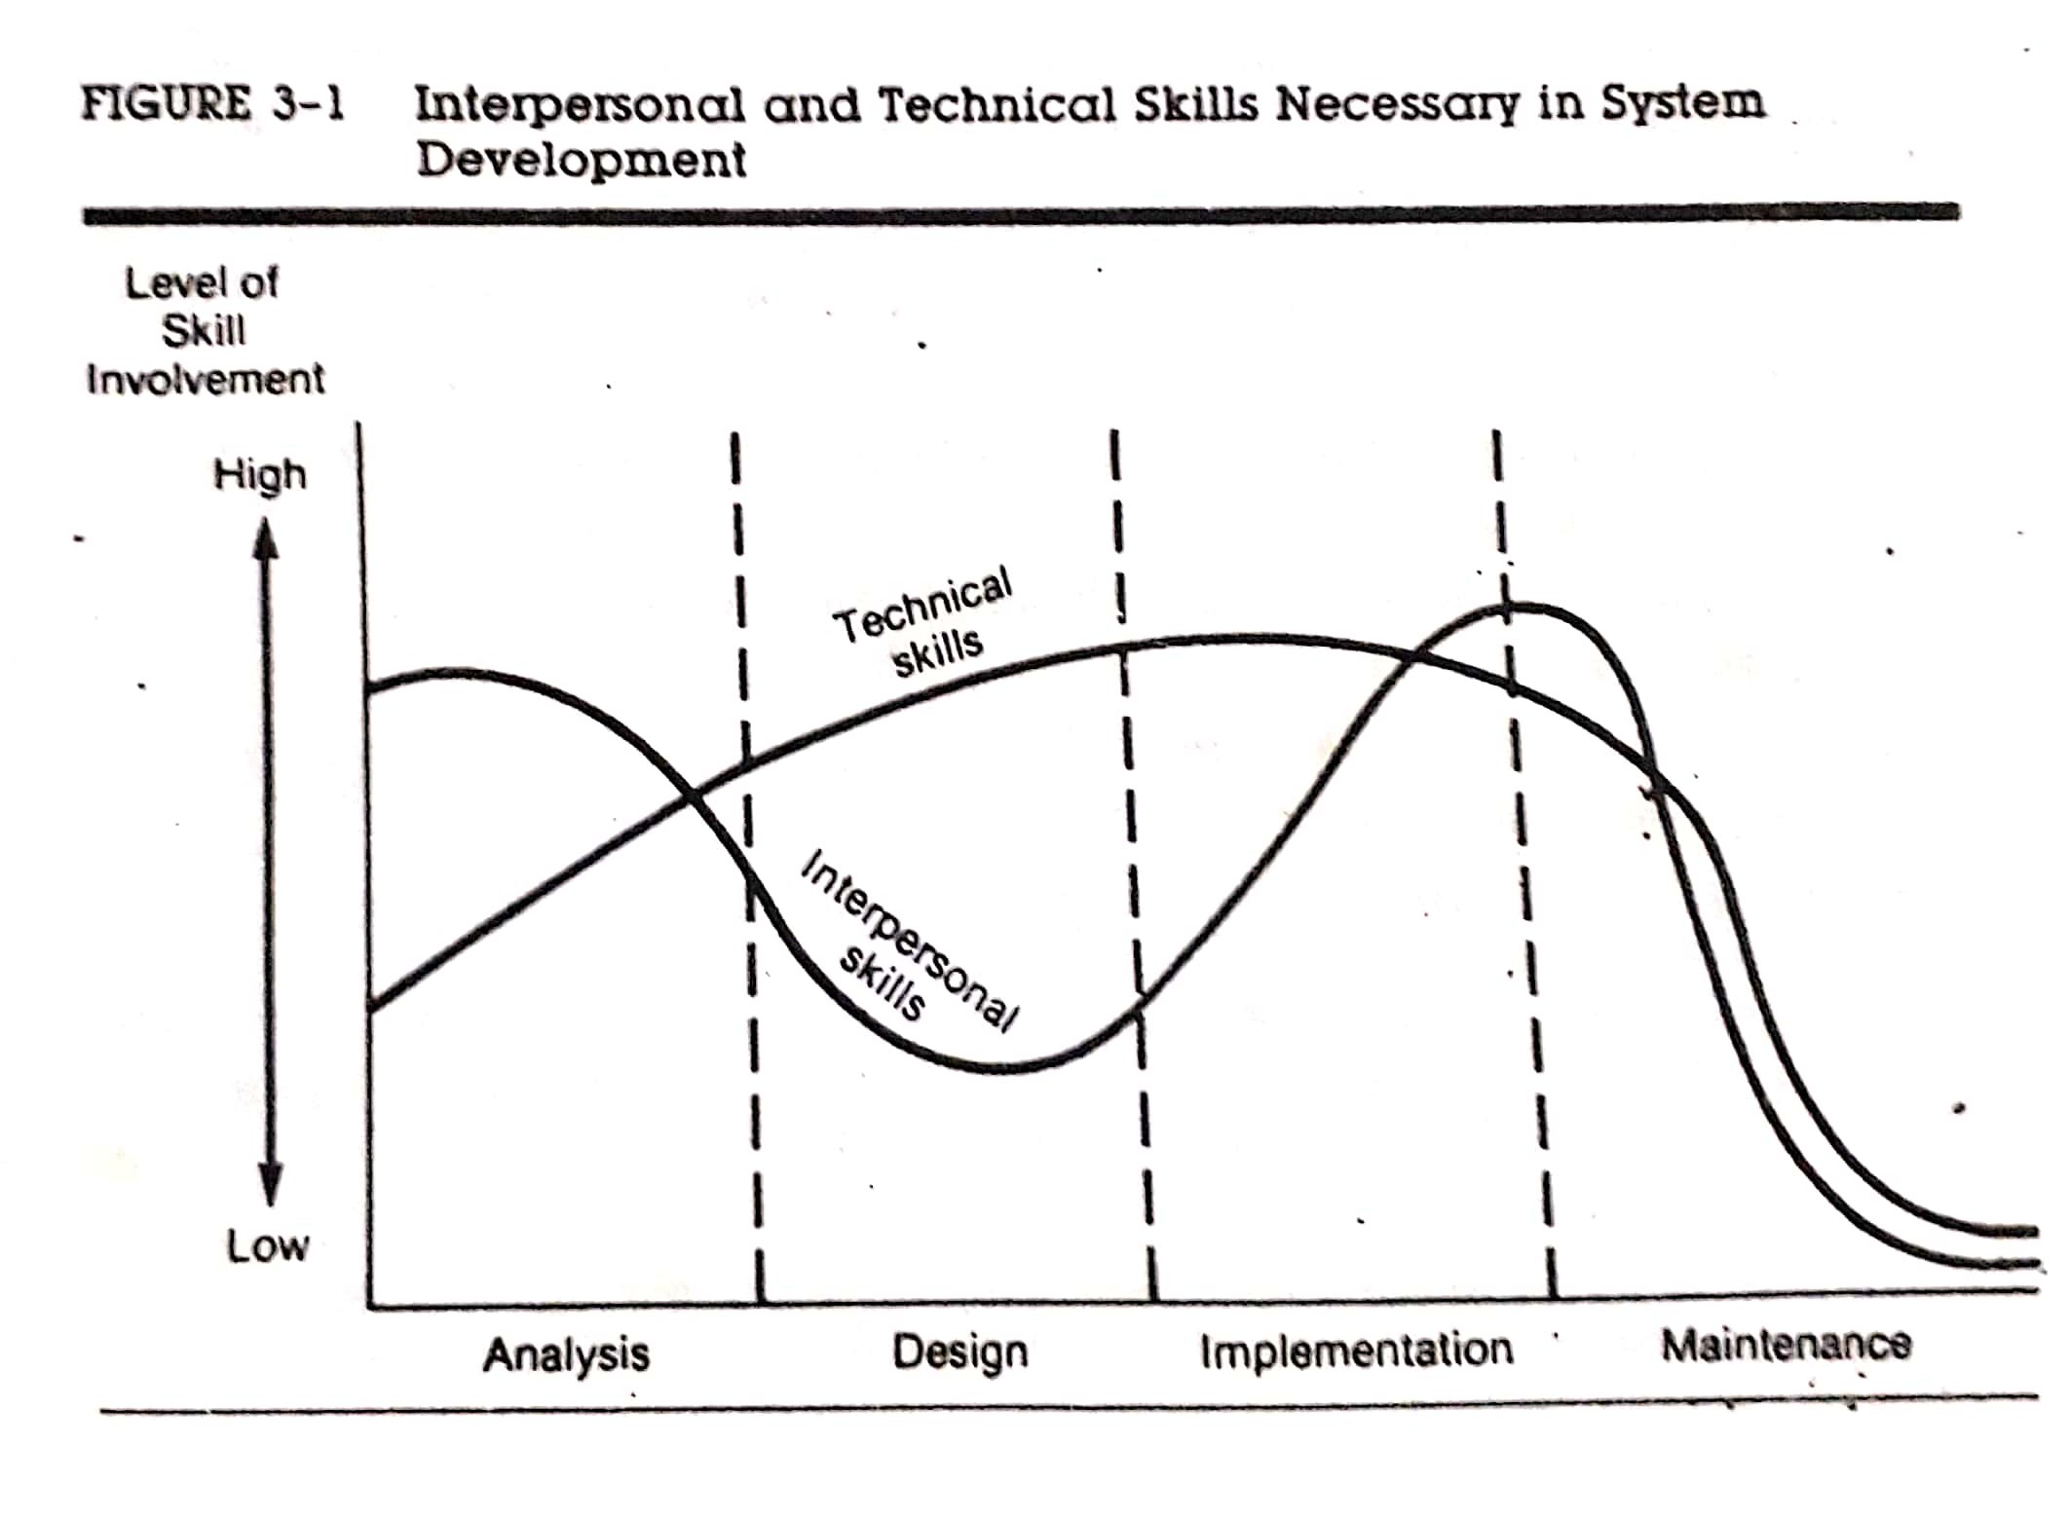
Skills Required for a System Analyst

Slide 10
Academic and Personal Qualifications
Acquiring such skills of an analyst depends on his education, experience and personality which include –
A background in systems theory and organization behavior.
Familiarity with the makeup and inner workings of major application areas such as financial accounting, personnel administration, marketing and sales, operations management, model building and production control.
Competence in system tools and methodologies and a practical knowledge of one or more programming and database languages.
Experience in hardware and software specifications which is important for selection.

Slide 11
Academic and Personal Qualifications
Some of the personal attributes of analysts include the following –
Authority – the confidence to tell people what to do. Leadership quality is important for project management and teamwork while maintaining deadlines.
Communication Skills – ability to articulate and focus on a problem area for logical solution.
Creativity – trying one’s own ideas, developing candidate systems using unique tools or methods.
Responsibility – making decisions on one’s own and accepting the consequences of these decisions.
Varied Skills – doing different projects and handling change.

Slide 12
The Multifaceted Role of the Analyst: Change Agent
An analyst may perform as an agent of system change between user and system –
Various types of changes may occur at different phases of system development.
It is important to secure user acceptance through user participation while introducing change and reorientation of the system to the user organization.
The system analyst may select various styles to introduce change to the user organization.
The styles range from that of persuader (mildest intervention) to imposer (severe intervention).
When the user appears to have a tolerance for change, the persuader style is appropriate. On the other hand, drastic changes require imposer style.
The goal is to achieve user acceptance of the candidate system with a minimum of resistance.

Slide 13
The Multifaceted Role of the Analyst: Investigator and Monitor
An analyst may perform as an investigator and monitor various aspects of a system –
An analyst works as an investigator by extracting the real problems from existing systems and creating information structures that uncover previously unknown trends that may have direct impact on the organization.
To undertake and successfully complete a project, the analyst must monitor programs in relation to time, cost and quality. Of these resources, time is the most important because untimely actions result in increased costs, wasted human resources and user frustration.
The analyst as a whole pieces together the information gathered to determine why the present system does not work well and what changes will correct the problem and also monitors the required resources and activities to cope with the change.

Slide 14
The Multifaceted Role of the Analyst: Architect
An analyst may perform as an architect to a user while designing a system conceptually –
The architect’s primary function as liaison between the client’s abstract design requirements and the contractors' detailed building plan maybe compared to the analyst’s role as liaison between the user’s logical design requirements and detailed physical system design.
A system analyst aids users in formalizing abstract ideas and provides details to build the end product – the candidate system.

Slide 15
The Multifaceted Role of the Analyst: Psychologist
An analyst may perform as a psychologist to users to understand their thoughts and ideas regarding the system –
The analyst plays the role of a psychologist in the way he/she reaches people, interprets their thoughts, assesses their behavior and draws conclusions from these interactions.
Understanding inter-functional relationships between user thoughts about the system is important.
It is important that the analyst be aware of people’s feelings and be prepared to get around things in a graceful way.
The art of listening is important in evaluating responses and feedback.

Slide 16
The Multifaceted Role of the Analyst: Salesperson
An analyst may perform as a salesperson to users in order to convince the use, applicability and performance of the developed system for a particular context –
Selling change can be as crucial as initiating change.
The oral presentation of the system proposal has one objective – selling the user on the system.
Selling the system actually takes place at each step in the system life cycle.
However, sales skills and persuasiveness are crucial to the success of the system.

Slide 17
The Multifaceted Role of the Analyst: Motivator
An analyst may perform as a motivator to users so that they are assured that the system is well designed and accept it for use –
System acceptance is achieved through user participation in its development, effective user training and proper motivation to user the system.
The analyst’s role as a motivator becomes obvious during the first few weeks after implementation and during times when turnover results in new people being trained to work with the candidate system.
The amount of dedication it takes to motivate users often overloads the analyst’s abilities to maintain the pace.
What was once viewed as a challenge can easily become a frustration is the user’s staff continues to resist the system.

Slide 18
The Multifaceted Role of the Analyst: Politician
An analyst may perform as a politician to motivate users to use the system –
In implementing a candidate system, the analyst tries to appease all parties involved.
Diplomacy and finesse in dealing with people can improve acceptance of the system.
As a politician mist have the support of his/her constituency, so as the system analyst’ goal is to have that support of the users for the developed system.
The analyst represents their thinking and tries to achieve their goals through computerization.

Slide 19
The Analyst/User Interface
A viable interface between the analyst and the user is a very important aspect of system development.
Analysts must devote as much skill and effort to achieve a productive relationship with the user as they devote to the technical requirements of the system.
Most research indicates as the number of user increases, the probability of system failure increases without close analyst/user interface.
In the past, there was an adversary relationship between the analyst and the user where changes were imposed on users and user involvement was limited.
Later growth in user-friendly technology, improved knowledge of the user in information system and maturity of the analyst paved the way for greater user participation in system development,

Slide 20
The Analyst/User Interface: Behavioral Issues
A viable interface between the analyst and the user is a very important aspect of system development. Increase reports of system failure that are not caused by technical problems made it necessary to seek a better understanding of the analyst/user interface.
User Motivation: The motivational approach in system development states that the candidate system should satisfy the user needs if they are going to use it.
Lucas’s descriptive model of user behavior identifies attitudinal, personal and situational decision making factors that affect system use.
The expectancy theory of user motivation stresses on the relationship between effort and performance. The user determines the probability that a certain level of user’s effort will improve job performance.
The expectancy theory of user motivation stresses on the relationship between performance and rewards. Individuals are motivated to perform works that would provide greater rewards after successful accomplishment.

Slide 21
The Analyst/User Interface: Behavioral Issues
A viable interface between the analyst and the user is a very important aspect of system development. Increase reports of system failure that are not caused by technical problems made it necessary to seek a better understanding of the analyst/user interface.
Analyst/User Differences: Differences in education, experience and language are quite obvious.
The analyst’s impatience with the user’s ignorance about certain terminology and user’s impatience with the analyst’s limited understanding of the business creates conflict in system development.
Users often expect the computer to solve all problems virtually
System analysts seems to view themselves as creators rather than participants in the development process.
Ignoring user suggestions produces analyst oriented rather than user oriented systems.
If the analyst follows a dominant analytical style and the users follow a heuristic style to process information rather than cognitive style, then the system development will gradually lead to failure in meeting the user needs.

Slide 22
The Analyst/User Interface: Political Factor
A viable interface between the analyst and the user is a very important aspect of system development. Increase reports of system failure that are not caused by technical problems made it necessary to seek a better understanding of the analyst/user interface.
Political Factor: The process of system development maybe viewed as a contest of power where analysts have the initial advantage.
System development is often viewed as a bargaining process where analysts and users attempt to enhance their power positions and self interests.
To achieve political rationality, the analyst should not brag about the technical aspects of the candidate system.
A system that is simple to explain and easy to understand is more readily accepted that a technical representation and also makes the user feel less vulnerable.

Slide 23
Conflict resolution
The role of the analyst requires coordinating a vast network of people’s ideas and integrating them into a comprehensive set of activities associated with system development.
Analysts are expected to adapt their own personal style and user personality factors to improve communication, mutual understanding and promote system success.
Related to the success of the system is the extent to which a commitment can be made to avoid future conflict.
DDR (Detailed Definition of Requirements) is a binding agreement between analysts and users which forces communication between the analyst and the user and bridges the knowledge gap by requiring all parties to be explicit.

Slide 24
The Place of the Analyst in the MIS Organization
The function of an MIS organization is grouping and assigning work elements to appropriate areas.
An MIS manager organizes by assigning tasks, dividing work into specific jobs and defining relationships among them.
The MIS organization structure encompasses supervisory levels, authority relationships and the general pattern of activities carried out by employees at each level.
There exists a direct line of authority or chain of command from the director of MIS services to each of the supervisors.
The line of authority permits a supervisor to exercise direct command over subordinates to carry out their tasks.

Slide 25
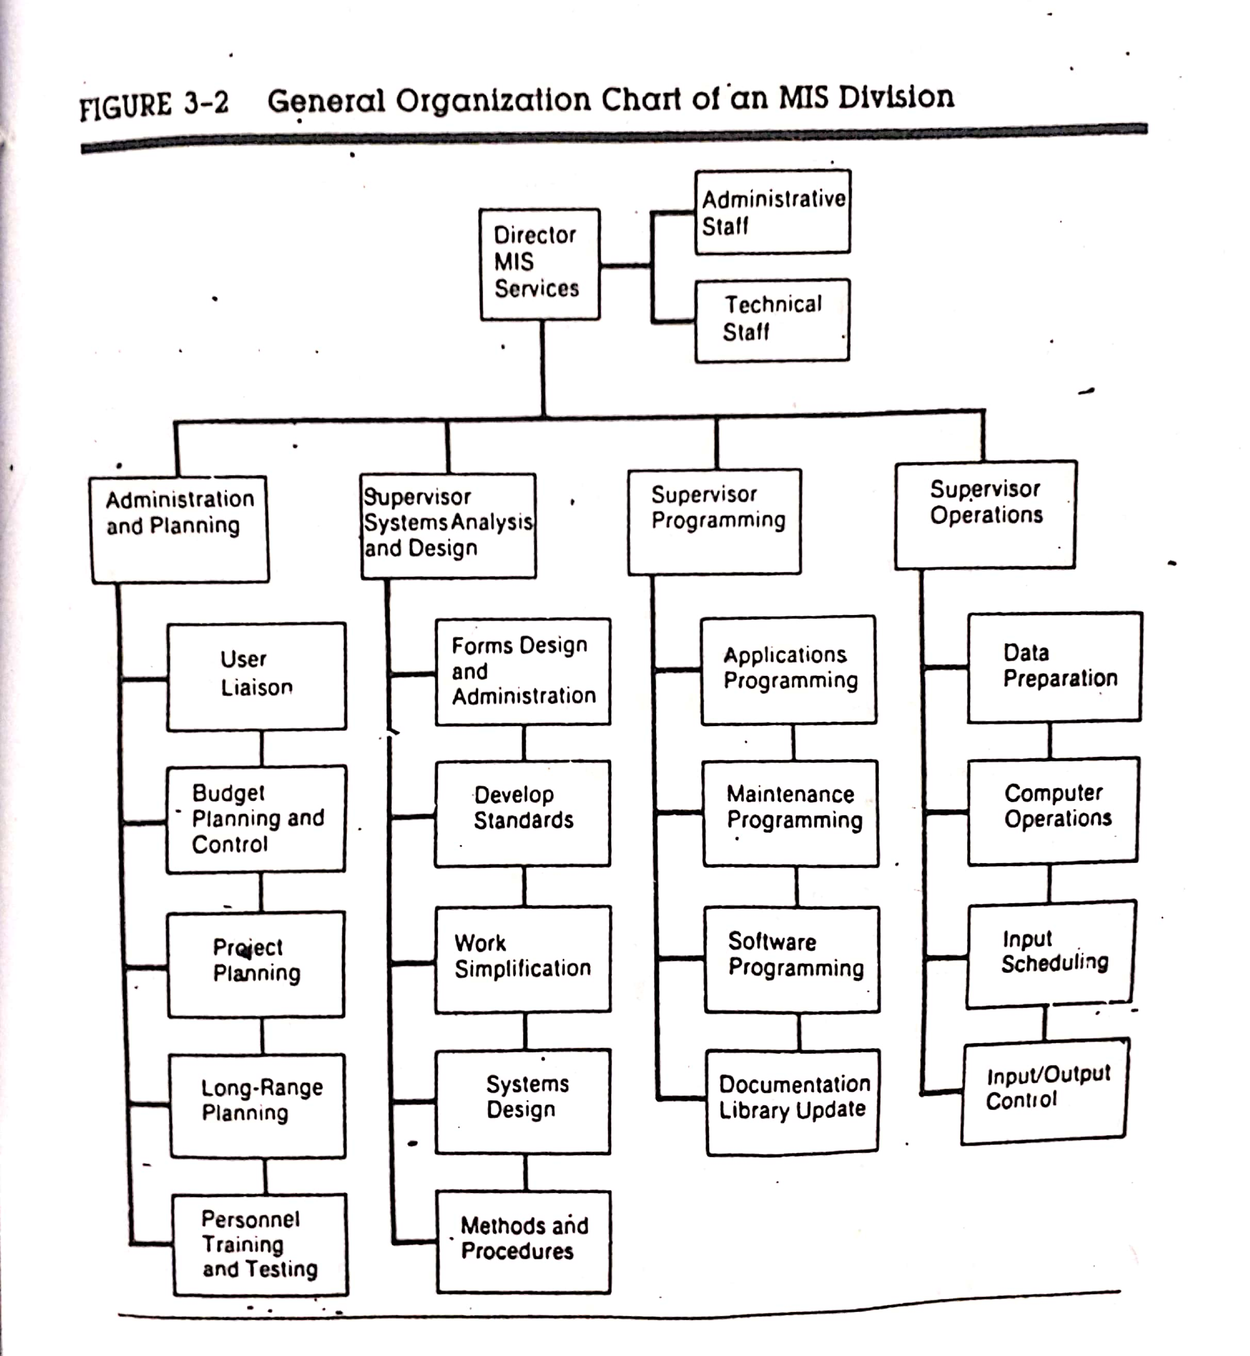
The Place of the Analyst in the MIS Organization

Slide 26
Primary Functions of an MIS Faculty
The main functions of an MIS facility center covers the following areas: administration, system analysis and design, programming and operations.
Administration is represented by four activities –
User liaison which handles the changing needs of the user and user system relationships.
Long range planning which includes personnel selection, recruitment, application development, and planning for anticipated changes in hardware and software.
Budget planning and control of the entire MIS division.
Personnel administration and training for upgrading employee skills.

Slide 27
Primary Functions of an MIS Faculty
The main functions of an MIS facility center covers the following areas: administration, system analysis and design, programming and operations.
2. System analysis and design maybe organized as follows –
Project-oriented: A team of analysts is formed to work on one project where each team has a project leader who reports directly to the systems manager. This is applicable for smaller installations that handle limited projects.
Pool-oriented: Analysts work on any system assignment within the firm. Once the job is completed they return to the pool for another assignment. This gives the department some control over its own application.
Functional Structure: A group of analysts is assigned to serve a specific system. Each team has a manager who reports directly to the director of system development. This is suitable for a large computing facility.

Slide 28
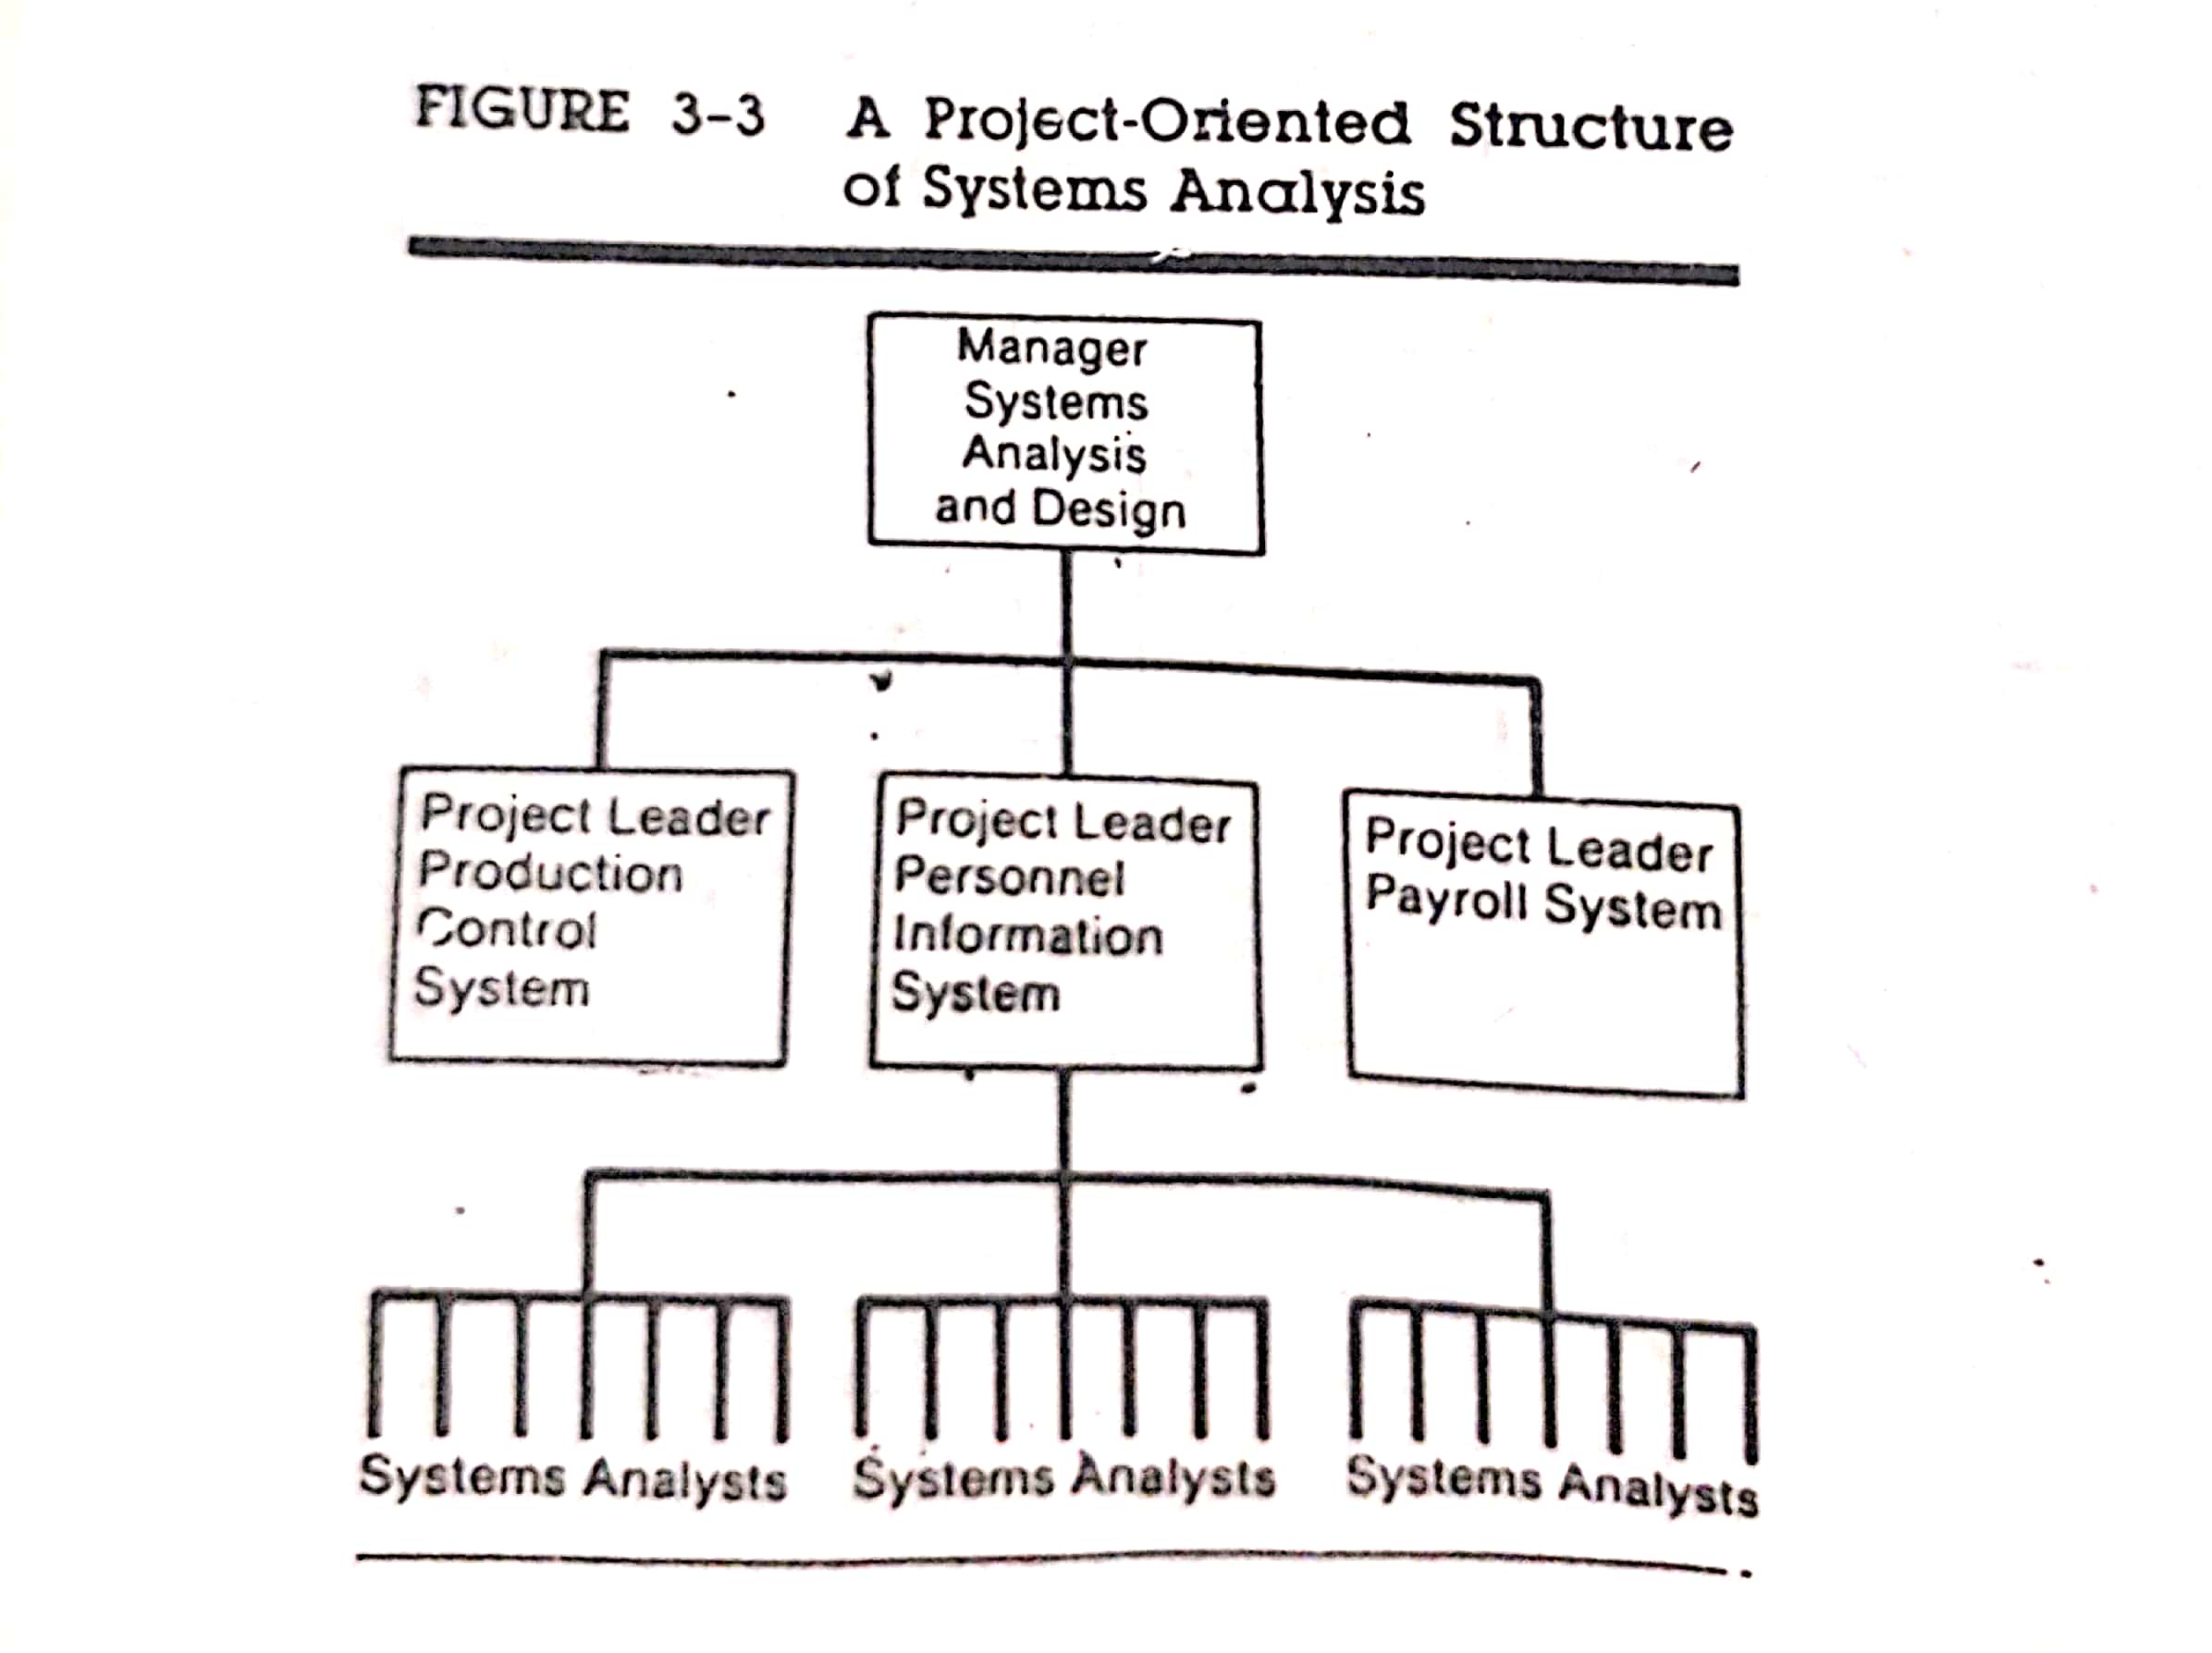
Primary Functions of an MIS Faculty

Slide 29
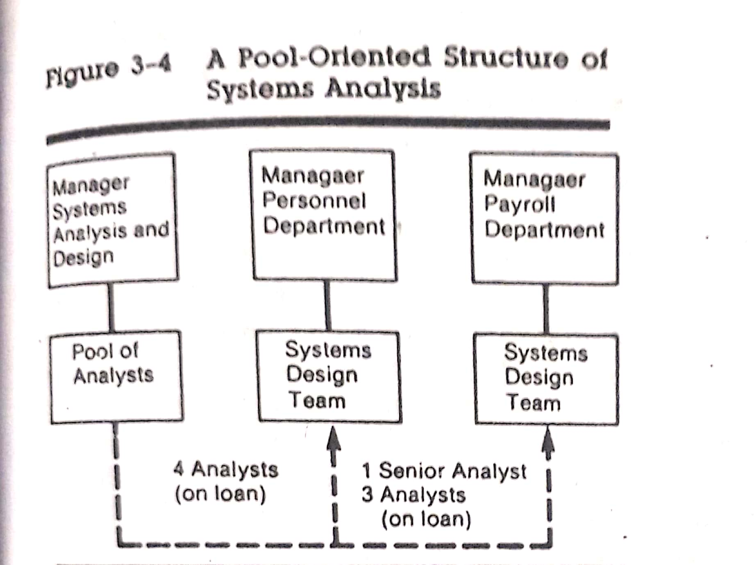
Primary Functions of an MIS Faculty

Slide 30
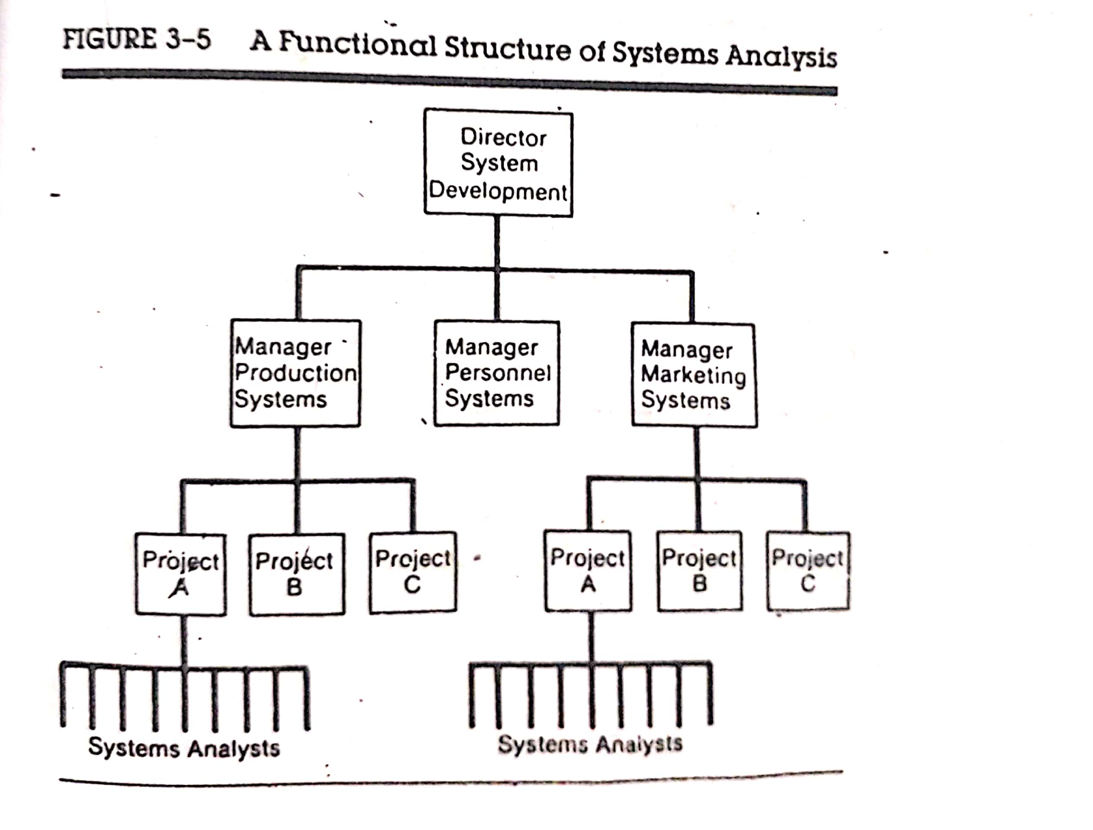
Primary Functions of an MIS Faculty

Slide 31
Primary Functions of an MIS Faculty
The main functions of an MIS facility center covers the following areas: administration, system analysis and design, programming and operations.
3. Programming is structured around three areas –
Applications: Application programmers are placed on the same project team with analysts.
Software: Software programmers are responsible for modifying compilers and software packages used by existing applications.
Maintenance: Maintenance programmers handle all changes required to keep a system operating.
Programming is organized on a pool or team basis.
The pool approach clusters programmers into a pool that reports to a supervisor. Each programmer is assigned a program to prepare through all stages.
The team approach assigns each programmer to a team that has responsibility for a specific project. Programmers report to a lead programmer who reports to the project leader.

Slide 32
Primary Functions of an MIS Faculty
The main functions of an MIS facility center covers the following areas: administration, system analysis and design, programming and operations.
4. Operations handle job scheduling and supportive services such as supplies inventory, programming and data library. These functions are coordinated with systems design and programming under a master plan.

Slide 33
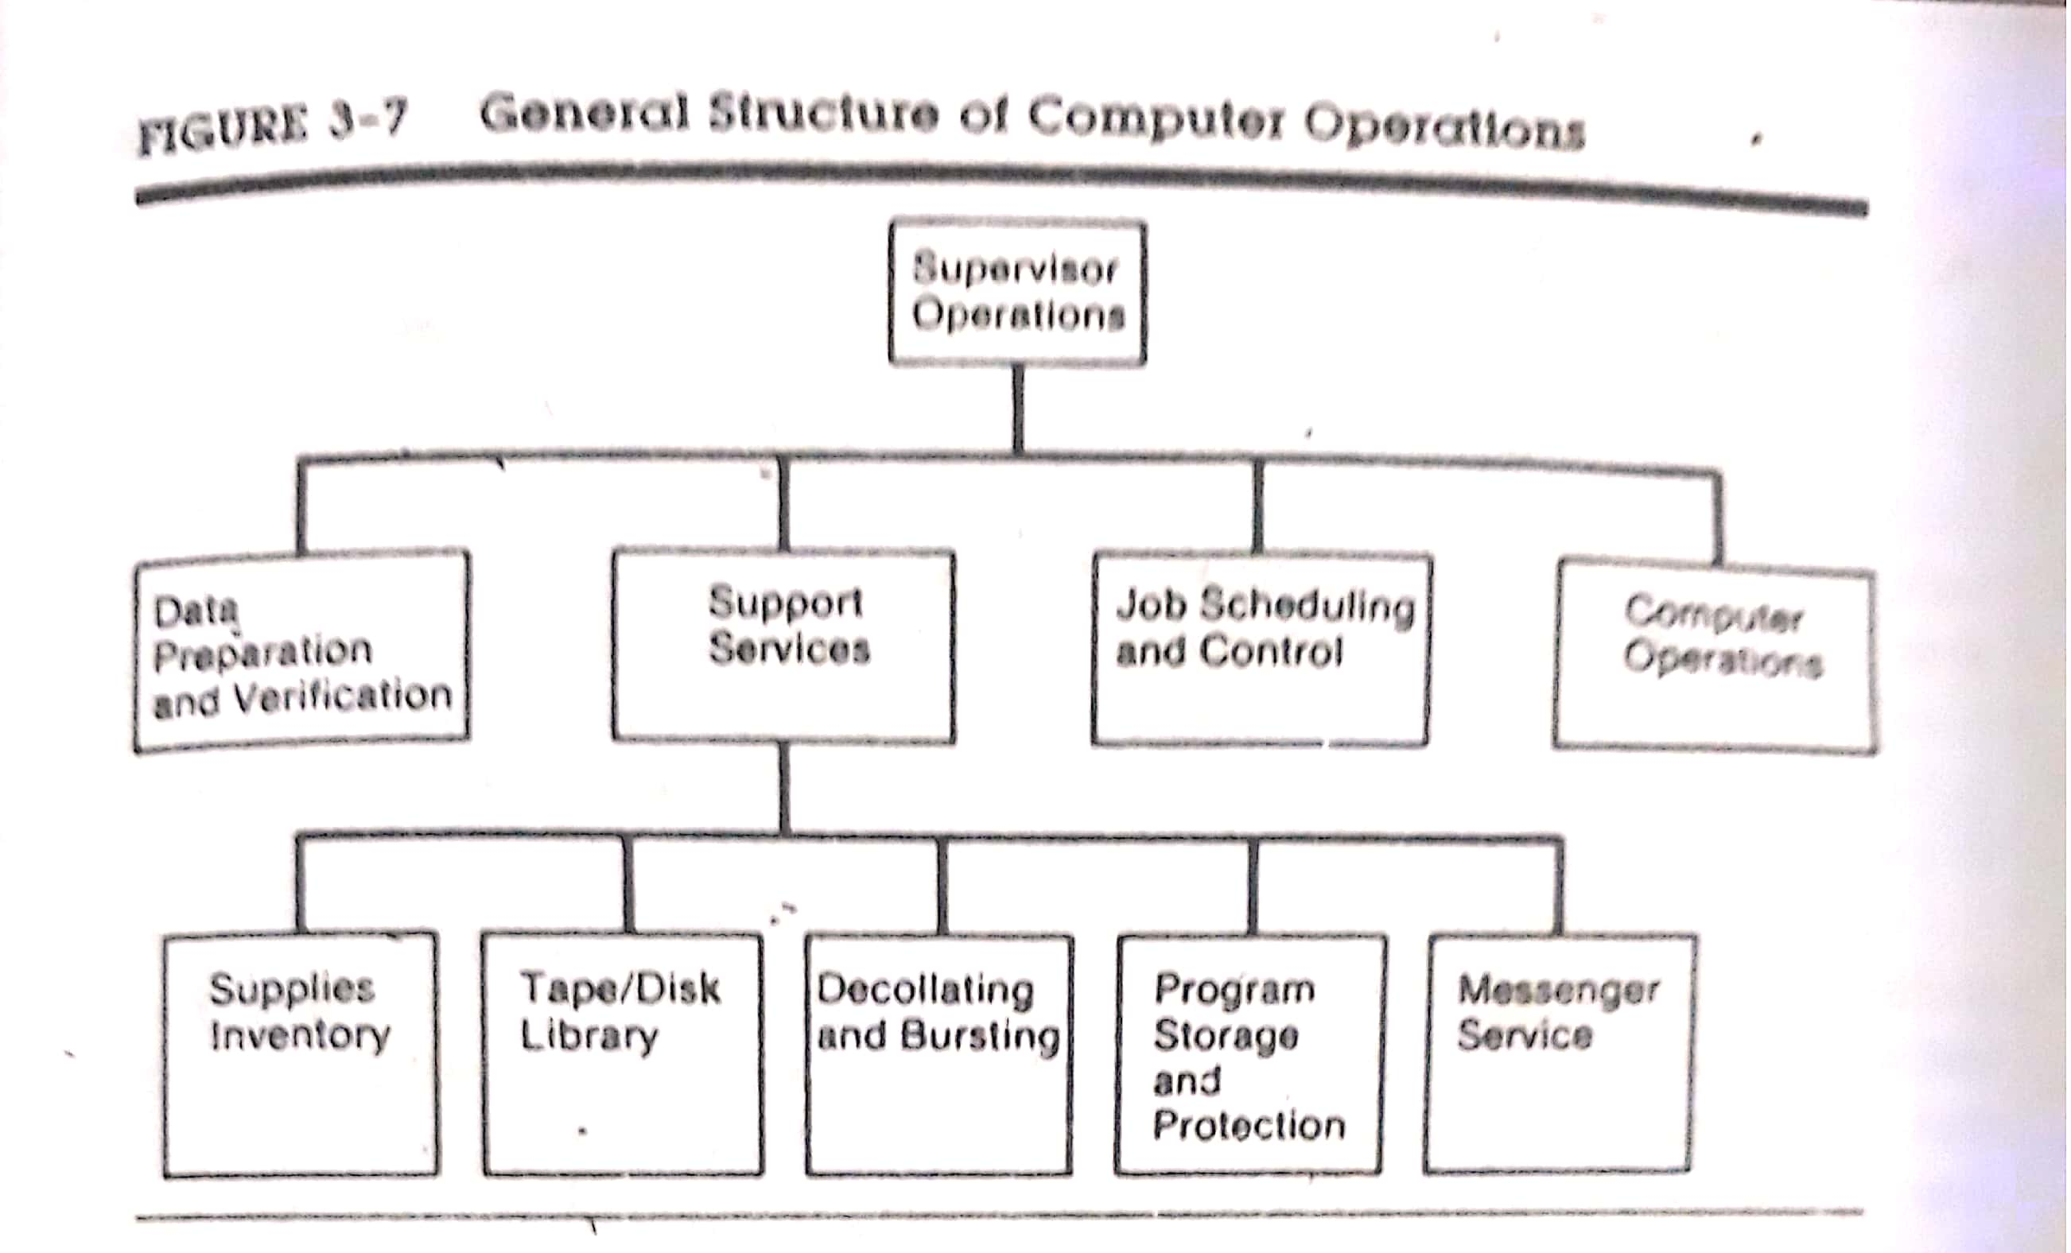
Primary Functions of an MIS Faculty

Slide 34
Functions of a Key System Personnel
Manager – MIS Services: The MIS manager is responsible for planning, organizing, coordinating and directing the activities for the entire work management division. The job requirements depend on the size of the firm an the sophistication of the MIS facility. The manager has become an executive who make decisions that can affect the functioning of the entire organization. The key qualities are –
Skill in planning, organizing and controlling the work of the division.
Ability to deal logically with difficult problem and cope with new situations.
Technical knowledge of hardware, software packages and networking.
Ability to relate to others.
Broad knowledge of business of the employing organization.

Slide 35
Functions of a Key System Personnel
Systems Supervisor/Manager – Systems Department: A second-level managerial position in the MIS division is the systems supervisor. The primary functions are –
Preparing long range plans for system projects.
Authorizing system projects.
Organizing and staffing project teams.
Preparing and maintaining system procedures.
Conducting system surveys and recommending system changes.
Establishing standards and specifications for proposed hardware.

Slide 36
Functions of a Key System Personnel
Project Leader – Systems Department: System management requires a project leader who is responsible for the entire project management and must work with analysts and users. Hence, to do the job well, technical and administrative background is important. The project leader reports to the manager of the systems department. The primary attributes are –
Ability to design systems and write procedures.
Ability to sell new ideas or new equipment to users.
Imagination in exploring new and better ways of designing systems.
Integrity in dealing with vendors and safeguarding company records.
Perceptiveness and understanding subordinates and how they react to work situations.

Slide 37
Functions of a Key System Personnel
System Analyst – Systems Department: A key member of the project team is the systems analyst. This job carries considerable responsibility, high status and attractive pay. System analysts have the highest perceived status in the MIS facility. The roles and responsibility of a system analyst have been already discussed.

Slide 38
Rising Positions in System Development
The Paraprofessional
The tasks that make up the system development process are changing with the increase in the use of structured tools.
There are emerging tasks that are less technical or creative than the traditional ones.
Rather than the analyst ignoring them or tying up valuable time, they are carried out by less experienced paraprofessionals.

Slide 39
Rising Positions in System Development
Tasks of the Paraprofessional
General Support Tasks
Maintain current documentation on a daily basis.
Maintain a technical literature and information retrieval service.
Assist in constructing and maintaining a program development library.

Slide 40
Rising Positions in System Development
Tasks of the Paraprofessional
2. Specific System Development Tasks
Draft data flow diagrams and structure charts based on specifications from system development personnel.
Maintain data dictionaries.
Code programs.
Prepare and maintain test data files, check test results and modify programs based on a predetermined procedure.
Prepare user manuals and other documentation.
Prepare supportive training materials when needed.

Slide 41
Rising Positions in System Development
Tasks of the Paraprofessional
According to Harris and Hoffman, paraprofessionals perform the tasks as follows –
The task is not significantly complex or does not require “high level” ability, education, skill or experience.
The task is repetitious and there is a relatively well defined process for performing it.
The general support tasks require limited time for instruction relative to the time it takes to perform them.
Some characteristics desirable in a paraprofessional are –
Communication skills.
Ability to think like the system person being supported.
Ability to work independently and perform with minimal supervision.
Creative problem solving ability and an attitude conducive to trying things out.

Slide 42
Rising Positions in System Development
The Technical Writer
Documentation is one of the best liaisons between the technical and user worlds.
As the number of user-driven system increases, their use and acceptance will be greatly influenced by the quality of system documentation .
From the rough draft, omissions, and contradictions the technical writer extracts a clean, lucid, set of instructions for the candidate system.
The writer seeks to uncover the hidden logic of the program and convert it into an operational pattern.
There are methods analysts who develop standards and procedures manuals, indexers, hardware and operations writer.

Slide 43
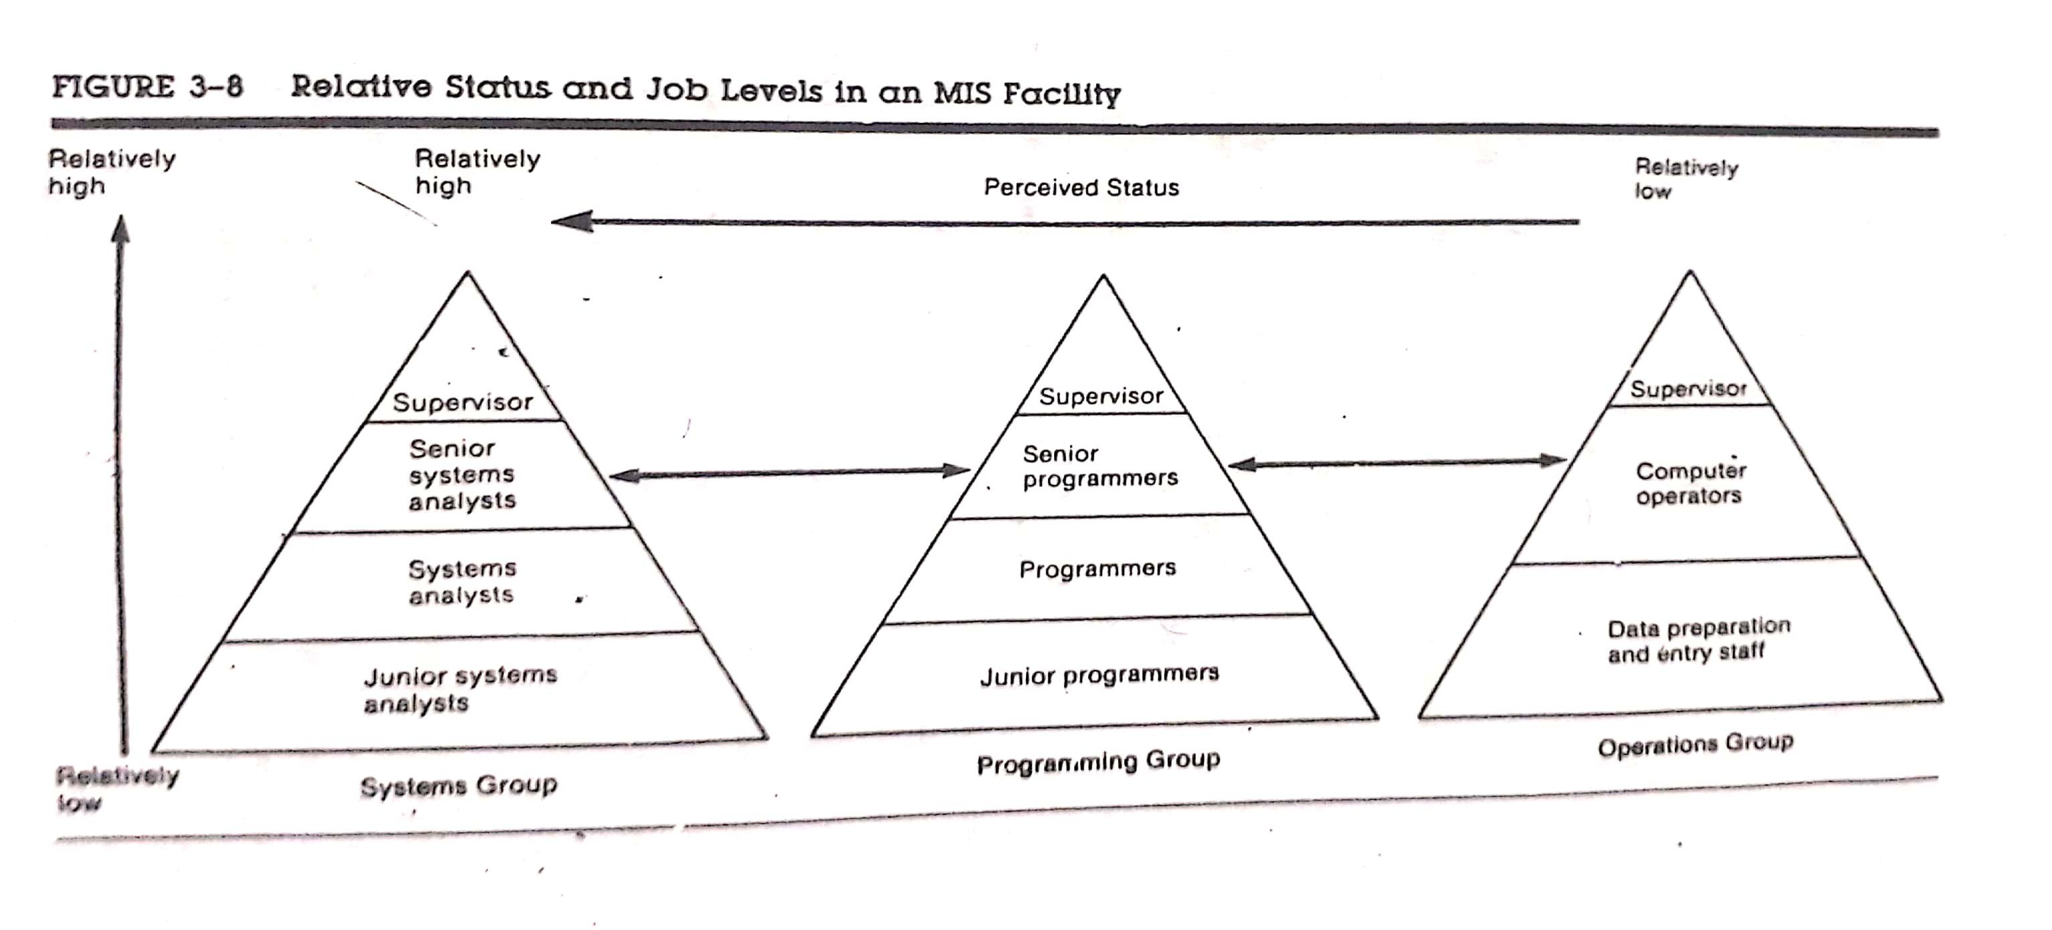
Rising Positions in System Development

Slide 44
THANK YOU

